Slide 1
Intermediate Code Generation
Dr. N. Kalyani
Professor, CSE

Slide 2
Contents
Intermediate-Code Generation:
Variants of Syntax Trees
Three-Address Code
Types and Declarations
Type checking
Control Flow
Back Patching
Switch Statements
Intermediate Code for Procedures

Slide 3
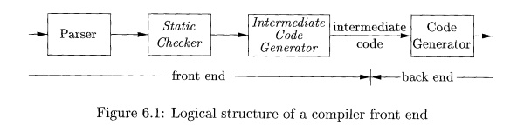
Parsing & Intermediate Code generation
In the analysis-synthesis model of a compiler, the front end analyzes a source program and creates an intermediate representation, from which the back end generates target code.
Source language is confined to the front end, and details of the target machine to the back end.
While parsing, static checking, and intermediate-code generation are done sequentially; All these can be combined and folded into parsing.

Slide 4
Intermediate Code Representation
Intermediate representations, including syntax trees and three-address code.
Syntax trees are high level; they depict the natural hierarchical structure of the source program and are well suited to tasks like static type checking /evaluation ordering.
A low-level representation is suitable for machine-dependent tasks like register allocation and instruction selection.
“Three-address code" comes from instructions of the general form x = y op z with three addresses: two for the operands y and z and one for the result x.
Three-address code can range from high to low-level, depending on the choice of operators.

Slide 5
Variants of Syntax Trees
Directed Acyclic Graphs for Expressions
The Value-Number Method for Constructing DAG's

Slide 6
1. Directed Acyclic Graphs for Expressions
Like the syntax tree for an expression,
A DAG has leaves corresponding to atomic operands and interior nodes corresponding to operators.
The difference is that a node N in a DAG has more than one parent if N represents a common subexpression.
In a syntax tree, the tree for the common subexpression would be replicated as many times as the subexpression appears in the original expression.
A DAG gives the compiler important clues regarding the generation of efficient code to evaluate the expressions.

Slide 7
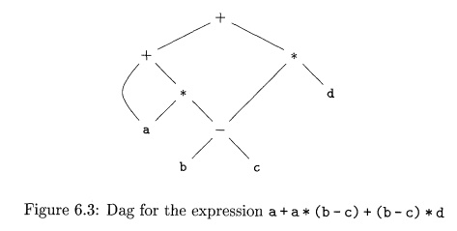
DAG for the expression
a + a * (b - c) + (b - c) * d

Slide 8
Construction of DAG
The SDD can construct either syntax trees or DAG’s.
It was used to construct syntax trees, where functions Leaf and Node created a fresh node each time they were called.
It will construct a DAG if, before creating a new node, these functions first check whether an identical node already exists.
If a previously created identical node exists, the existing node is returned.

Slide 9
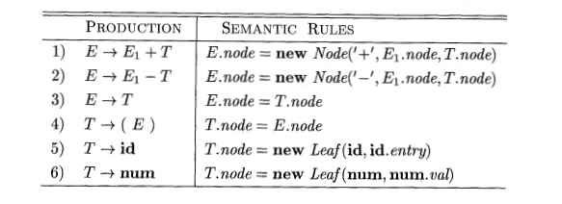
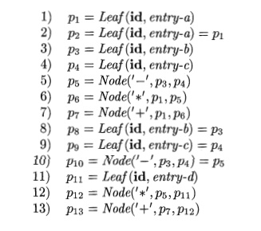
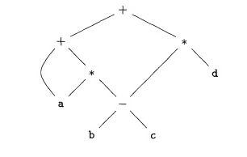
SDD to produce Syntax tree or DAG

Slide 10
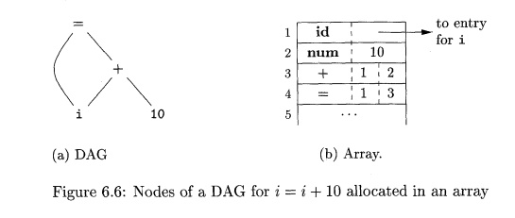
2. The Value-Number Method for Constructing DAG's

Slide 11
2. The Value-Number Method for Constructing DAG's
Algorithm : The value-number method for constructing the nodes of a DAG.
INPUT : Label op, node l, and node r.
OUTPUT : The value number of a node in the array with signature (op, l, r).
METHOD :
Search the array for a node M with label op, left child I, and right child r.
If there is such a node, return the value number of M.
If not, create in the array a new node N with label op, left child I, and right child r, and return its value number.

Slide 12
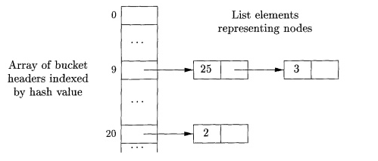
Essential data structure to construct DAG
The hash table is one of several data structures that support dictionaries efficiently.
To construct a hash table for the nodes of a DAG, we need a hash function h that computes the index of the bucket for a signature (op, I, r).
The bucket index h(op, I, r) is computed deterministically from op, I, and r, so that we may repeat the calculation and always get to the same bucket index for node (op, I, r).

Slide 13
Exercise
Construct the DAG for the expression
((a + y)- ((x + y)*(x- y))) + ((x + y) * (x - y))

Slide 14
Three-Address Code
Addresses and Instructions
Quadruples
Triples
Static Single-Assignment Form

Slide 15

Three-Address Code
Three-address code - One operator and two operands on right side.
For expression like x+y*z might be translated into the sequence of three-address instructions
where t₁ and t₂ are compiler-generated temporary names.
The use of names for the intermediate values computed by a program allows three-address code to be rearranged easily.

Slide 16
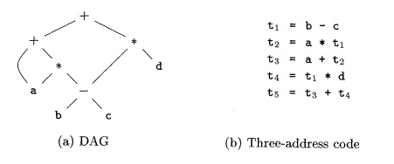
DAG for the expression
a + a * (b - c) + (b - c) * d

Slide 17
Addresses and Instructions to build Three-address code
Three -address code can be implemented using records called quadruples and triples
An address can be one of the following:
A name : For convenience, we allow source-program names (pointer to its symbol-table entry) to appear as addresses in three-address code.
A constant : In practice, a compiler must deal with many different types of constants and variables.
A compiler-generated temporary : Useful, especially in optimizing compilers, to create a distinct name each time a temporary is needed. These temporaries can be combined, if possible, when registers are allocated to variables.

Slide 18
Addresses and Instructions to build Three-address code
A symbolic label represents the index of a three-address instruction in the sequence of instructions. Actual indexes can be substituted for the labels, either by making a separate pass or by "backpatching,"
Assignment instructions of the form x = y op z, where op is a binary arithmetic or logical operation, and x, y, and z are addresses.
Assignments of the form x = op y, where op is a unary operation. Essential unary operations include unary minus, logical negation, shift operators, and conversion operators (int, float, etc).
Copy instructions of the form x = y, where x is assigned the value of y.
An unconditional jump go to L. The three-address instruction with label L is the next to be executed.

Slide 19
Addresses and Instructions to build Three-address code
Conditional jumps of the form if x goto L and if False x goto L. These instructions execute the instruction with label L next if x is true and false, respectively. Otherwise, the following three-address instruction in sequence is executed next, as usual.
Conditional jumps such as if x relop y goto L, which apply a relational operator (<, ==, >=, etc.) to x and y, and execute the instruction with label L next if x stands in relation relop to y. If not, the three-address instruction following if x relop y goto L is executed next, in sequence.
Procedure calls and returns are implemented using the following instructions: param x for parameters; call p , n and y = call p , n for procedure and function calls, respectively; and return y, where y, representing a returned value, is optional. Their typical use is as the sequence of three-address instructions

Slide 20
Addresses and Instructions to build Three-address code
Indexed copy instructions of the form x = y[i] and x[i] = y. The instruction x = y[i] sets x to the value in the location i memory units beyond location y. The instruction x[i] =y sets the contents of the location i units beyond x to the value of y.
Address and pointer assignments of the form x = &y, x = * y, and * x = y.
x = &y sets the r-value of x to be the location (l-value) of y.
x = *y, The r-value of x is made equal to the contents of the r-value of location y.
*x = y sets the r-value of the object pointed to by x to the r-value of y.

Slide 21
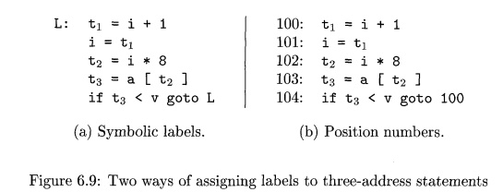
Addresses and Instructions to build Three-address code
Consider the statement do i = i + 1 ; while ( a [ i ] < v ) ;

Slide 22
2. Quadruples
A quadruple (or just "quad!') has four fields op, arg1, arg2, result.
op field contains an internal code for the operator, agr 1 and arg2 are the arguments and the fourth field is the result.
For instance, the three-address instruction x = y + z is represented by placing + in op, y in arg1, z in arg2, and x in result.
The following are some exceptions to this rule:
1. Instructions with unary operators like x = minus y or x = y do not use arg2. Note that for a copy statement like x = y, op is =, while for most other operations, the assignment operator is implied.
2. Operators like param use neither arg2 nor result.
3. Conditional and unconditional jumps put the target label in result.

Slide 23
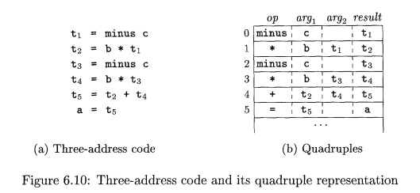
2. Quadruples
Three-address code for the assignment a = b * - c + b * - c

Slide 24
3. Triples
A triple has only three fields, which we call op, arg1, and arg2.
Using triples, we refer to the result of an operation x op y by its position, rather than by an explicit temporary name.
A triple representation would refer to position (0). Parenthesized numbers represent pointers into the triple structure itself.
Triples are equivalent to signatures in Value numbering method. The DAG and triple representations of expressions are equivalent.
The equivalence ends with expressions, since syntax-tree variants and three-address code represent control flow quite differently.

Slide 25
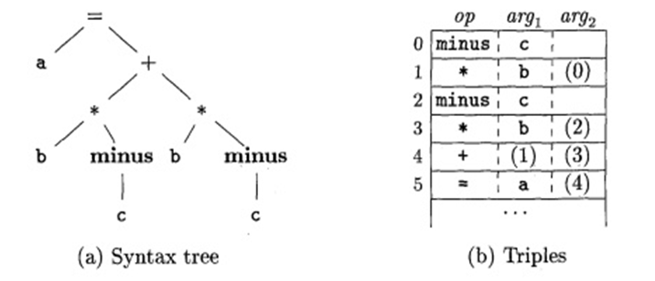
3. Triples
a = (b * - c) + (b * - c)

Slide 26
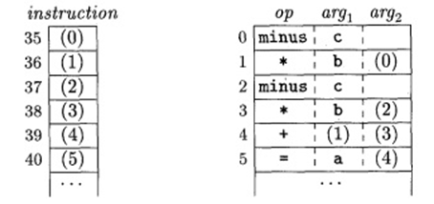
Indirect triples
Indirect triples consist of a listing of pointers to triples, rather than a listing of triples themselves.
With indirect triples, an optimizing compiler can move an instruction by reordering the instruction list, without affecting the triples themselves.
When implemented in Java, an array of instruction objects is analogous to an indirect triple representation, since Java treats the array elements as references to objects.

Slide 27
Translate the arithmetic expression
a + - (a -b- c)
a = b[i] + c[j]
A syntax tree.
Quadruples.
Triples.
Indirect triples.

Slide 28
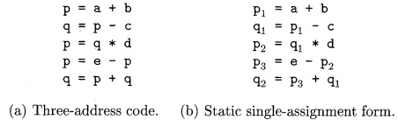
Static Single-Assignment Form
Static single-assignment form (SSA) is an intermediate representation that facilitates certain code optimizations.
Two distinctive aspects distinguish SSA from three-address code.
The first is that all assignments in SSA are to variables with distinct names; hence the term static single-assignment.
Note that subscripts distinguish each definition of variables p and q in the SSA representation.
The same variable may be defined in two different control-flow paths in a program.

Slide 29
Types and Declarations
1 Type Expressions
2 Type Equivalence
3 Declarations
4 Storage Layout for Local Names
5 Sequences of Declarations

Slide 30
Types and Declaration
Type checking
It uses logical rules to reason about the behavior of a program at run time.
Specifically, it ensures that the types of the operands match the type expected by an operator.
Example : && operator expects its two operands to be Booleans, the result is also of type Boolean.
Translation Applications
From the type of a name, a compiler can determine the storage that will be needed for that name at run time.
Type information is also needed to calculate the address denoted by an array reference, to insert explicit type conversions.

Slide 31
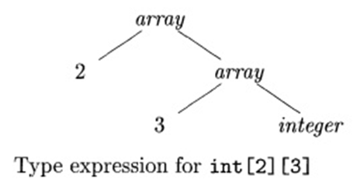
1. Type Expressions
Types have structure, which we shall represent using type expressions.
A type expression is either a basic type or is formed by applying an operator called a type constructor to a type expression.
The sets of basic types and constructors depend on the language to be checked.

Slide 32
1. Type Expressions
Definition of type expressions:
A basic type is a type expression. Typical basic types for a language include Boolean, char, integer, float, and void.
A type name is a type expression.
A type expression can be formed by applying the array type constructor to a number and a type expression.
A record is a data structure with named fields. A type expression can be formed by applying the record type constructor to the field names and their types.
A type expression can be formed by using the type constructor →• for function types. We write s —»• t for "function from type s to type t."

Slide 33
Type Names and Recursive Types
Once a class is defined, its name can be used as a type name
Example: consider Node in the program fragment
public class Node { • • • }
public Node n;
Names can be used to define recursive types, which are needed for data structures such as linked lists.
class Cell { int info; Cell next; ••• }
Similar recursive types can be defined using records and pointers.
If s and t are type expressions, then their Cartesian product s x t is a type expression.

Slide 34
2. Type Equivalence
When type expressions are represented by graphs, two types are structurally equivalent if and only if one of the following conditions is true:
They are the same basic type.
They are formed by applying the same constructor to structurally equivalent types.
One is a type name that denotes the other.
If type names are treated as standing for themselves, then the first two conditions in the above definition lead to name equivalence of type expressions.
Name-equivalent expressions are assigned the same value number, if used.

Slide 35
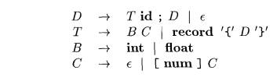
3. Declarations
A simplified grammar that declares just one name at a time and declarations with lists of names.
The above grammar that deals with basic and array types was used to illustrate inherited attributes.
Nonterminal D generates a sequence of declarations.
Nonterminal T generates basic, array, or record types.
Nonterminal B generates one of the basic types int and float.
Nonterminal C, for "component," generates strings of zero or more integers, each integer surrounded by brackets.

Slide 36
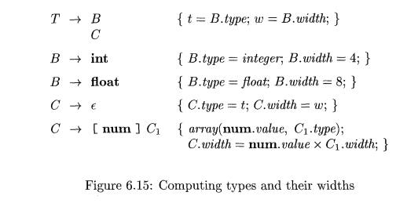
4. Storage Layout for Local Names

Slide 37
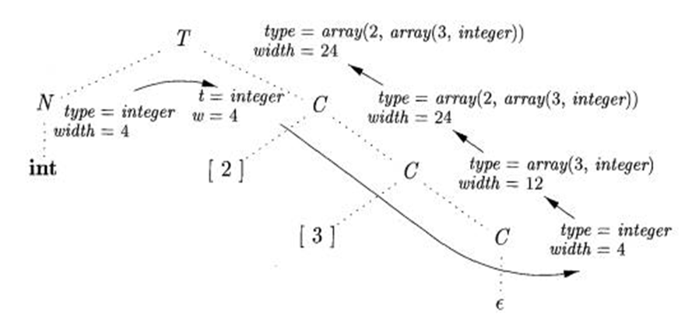
4. Storage Layout for Local Names
parse tree for the type int [2][3]

Slide 38
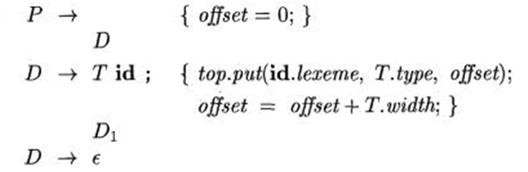
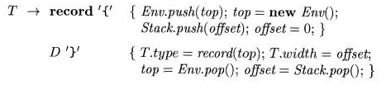
5. Sequences of Declarations

